Slide 1
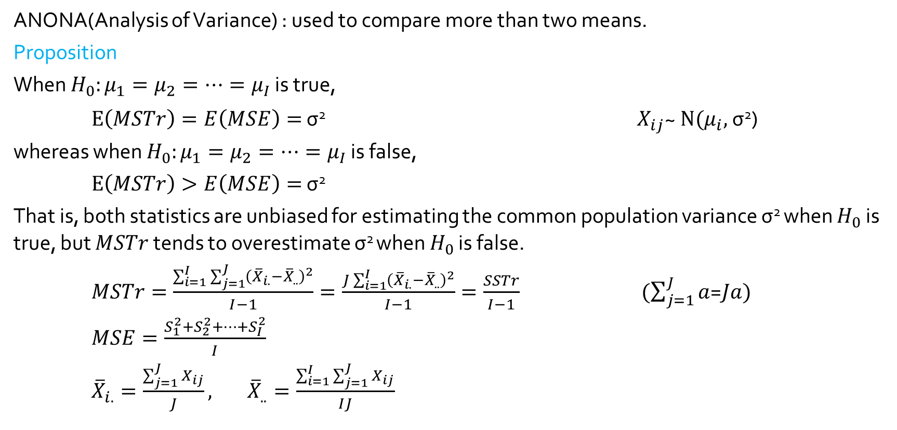
ANOVA
ANONA(Analysis of Variance) : used to compare more than two means.
Proposition
When $H_{0}:μ_{1}=μ_{2}=⋯{=μ}_{I}$ is true,
$E\left(MSTr\right)=E\left(MSE\right)=$ σ² $X_{ij}$~ $N(μ_{i},$σ²)
whereas when $H_{0}:μ_{1}=μ_{2}=⋯{=μ}_{I}$ is false,
$E\left(MSTr\right)>E\left(MSE\right)=$ σ²
That is, both statistics are unbiased for estimating the common population variance σ² when $H_{0}$ is true, but $MSTr$ tends to overestimate σ² when $H_{0}$ is false.
$MSTr=\frac{\sum_{i=1}^{I}{\sum_{j=1}^{J}{{\left({\overline{X}}_{i.}−{\overline{X}}_{..}\right)}^{2}}}}{I−1}=\frac{J\sum_{i=1}^{I}{{\left({\overline{X}}_{i.}−{\overline{X}}_{..}\right)}^{2}}}{I−1}=\frac{SSTr}{I−1}$ $(\sum_{j=1}^{J}{a}$=$Ja)$
$MSE=\frac{S_{1}^{2}+S_{2}^{2}+⋯+S_{I}^{2}}{I}$
${\overline{X}}_{i.}=\frac{\sum_{j=1}^{J}{X_{ij}}}{J},$ ${\overline{X}}_{..}=\frac{\sum_{i=1}^{I}{\sum_{j=1}^{J}{X_{ij}}}}{IJ}$

Slide 2
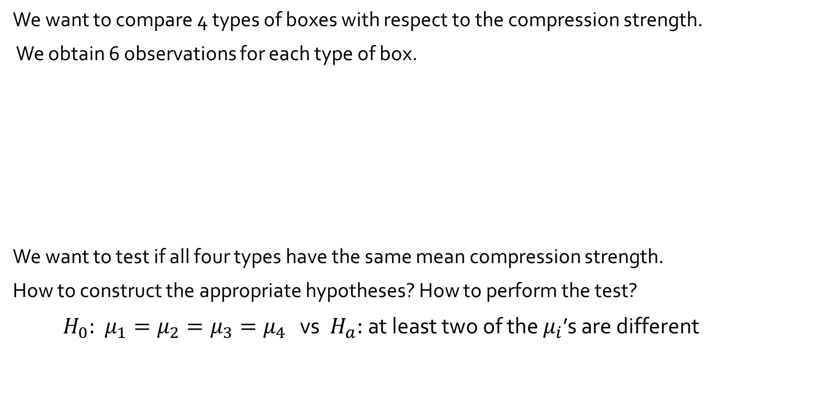
10.1 Single Factor ANOVA Example 10.1
We want to compare 4 types of boxes with respect to the compression strength.
We obtain 6 observations for each type of box.
We want to test if all four types have the same mean compression strength.
How to construct the appropriate hypotheses? How to perform the test?
$H_{0}:$ $μ_{1}=μ_{2}=μ_{3}=μ_{4}$ vs $H_{a}:$ at least two of the $μ_{i}$’s are different
Type of Box | Compression Strength (lb) | Sample Mean | Sample SD
1 2 3 4 | 655.5 788.3 734.3 721.4 679.1 699.4 789.2 772.5 786.9 686.1 732.1 774.8 737.1 639.0 696.3 671.7 717.2 727.1 535.1 628.7 542.4 559.0 586.9 520.0 Grand mean = | 713.00 756.93 698.07 562.02 682.50 | 46.55 40.34 37.20 39.87

Slide 3
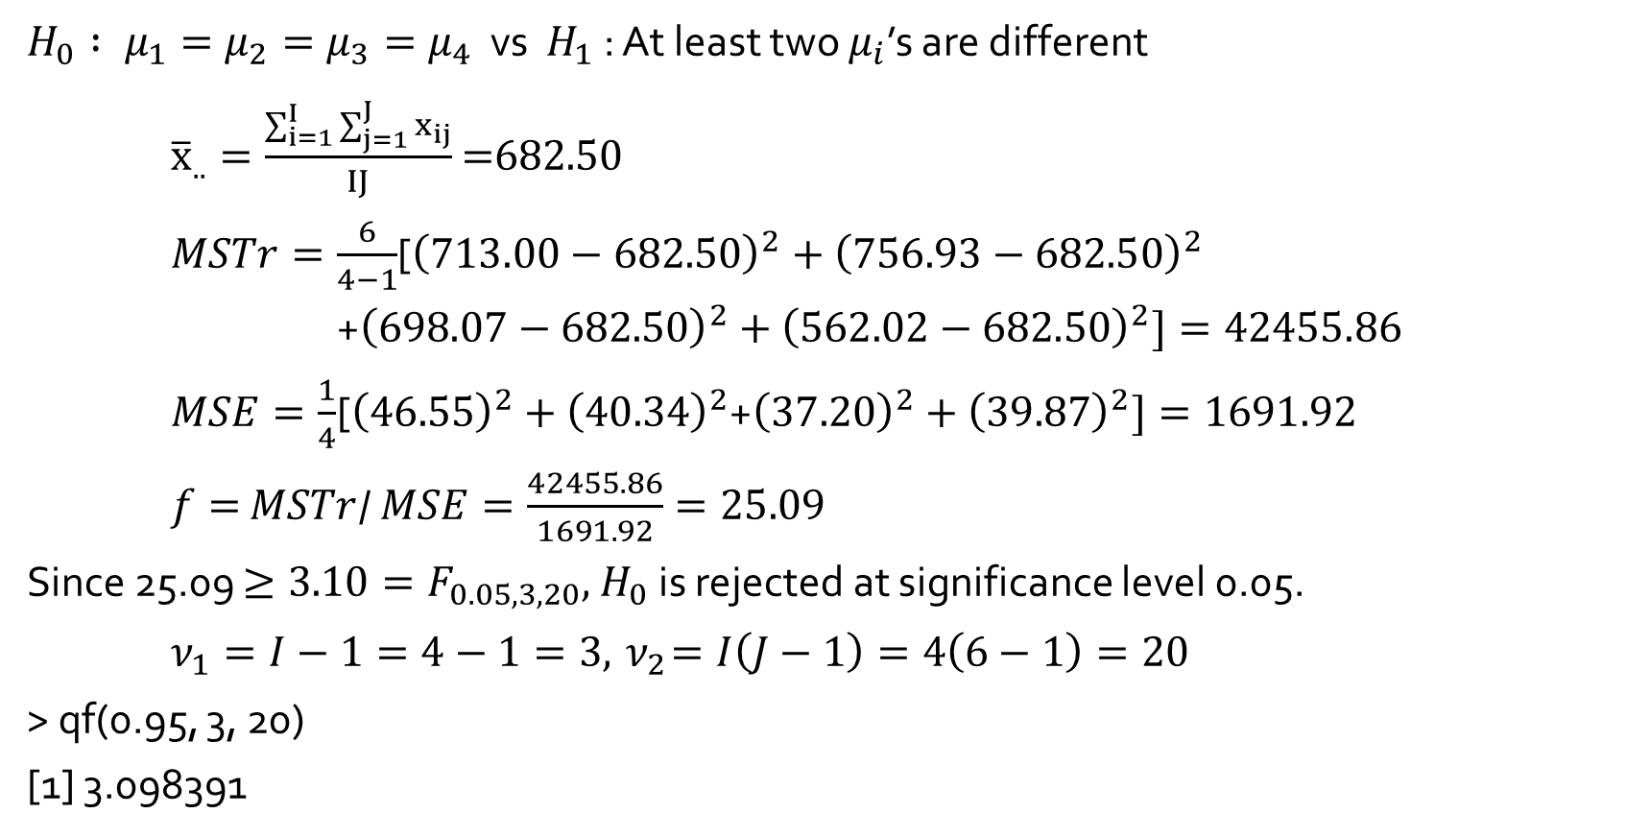
Example 10.2 (Example 10.1 continued) :
$H_{0} : μ_{1}=μ_{2}=μ_{3}=μ_{4}$ vs $H_{1}$ : At least two $μ_{i}$’s are different
${\overline{x}}_{..}=\frac{\sum_{i=1}^{I}{\sum_{j=1}^{J}{x_{ij}}}}{IJ}$ =682.50
$MSTr=\frac{6}{4−1}$[${\left(713.00−\text{682.50}\right)}^{2}+{\left(756.93−\text{682.50}\right)}^{2}$
+${\left(698.07−\text{682.50}\right)}^{2}+{\left(562.02−\text{682.50}\right)}^{2}]=42455.86$
$MSE=\frac{1}{4}$[${\left(46.55\right)}^{2}+{\left(40.34\right)}^{2}$+${\left(37.20\right)}^{2}+{\left(39.87\right)}^{2}]=1691.92$
$f=$ $MSTr$/ $MSE=\frac{42455.86}{1691.92}=25.09$
Since 25.09 $≥3.10=F_{0.05, 3, 20},{ H}_{0}$ is rejected at significance level 0.05.
$ν_{1}=I−1=4−1=3, { ν}_{2}=I\left(J−1\right)=4\left(6−1\right)=20$
> qf(0.95, 3, 20)
[1] 3.098391

Slide 4
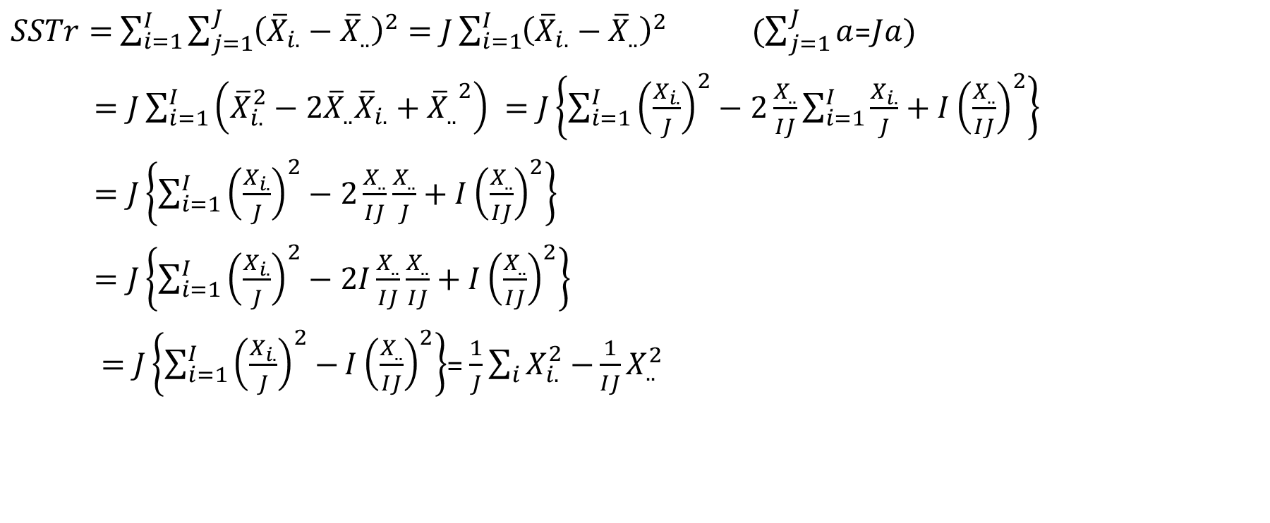
Sum of Squares
$SSTr=$ $\sum_{i=1}^{I}{\sum_{j=1}^{J}{{\left({\overline{X}}_{i.}−{\overline{X}}_{..}\right)}^{2}}}=J\sum_{i=1}^{I}{{\left({\overline{X}}_{i.}−{\overline{X}}_{..}\right)}^{2}}$ $(\sum_{j=1}^{J}{a}$=$Ja)$
$=J\sum_{i=1}^{I}{\left({\overline{X}}_{i.}^{2}−{2\overline{X}}_{..}{\overline{X}}_{i.}+{{\overline{X}}_{..}}^{2}\right) }=J\left\{\sum_{i=1}^{I}{{\left(\frac{X_{i.}}{J}\right)}^{2}−2\frac{X_{..}}{IJ}}\sum_{i=1}^{I}{\frac{X_{i.}}{J}+I{\left(\frac{X_{..}}{IJ}\right)}^{2}}\right\}$
$=J\left\{\sum_{i=1}^{I}{{\left(\frac{X_{i.}}{J}\right)}^{2}−2\frac{X_{..}}{IJ}}\frac{X_{..}}{J}+I{\left(\frac{X_{..}}{IJ}\right)}^{2}\right\}$
$=J\left\{\sum_{i=1}^{I}{{\left(\frac{X_{i.}}{J}\right)}^{2}−2I\frac{X_{..}}{IJ}}\frac{X_{..}}{IJ}+I{\left(\frac{X_{..}}{IJ}\right)}^{2}\right\}$
$=J\left\{\sum_{i=1}^{I}{{\left(\frac{X_{i.}}{J}\right)}^{2}−}I{\left(\frac{X_{..}}{IJ}\right)}^{2}\right\}$= $\frac{1}{J}\sum_{i}{X_{i.}^{2}−}\frac{1}{IJ}X_{..}^{2}$

Slide 5
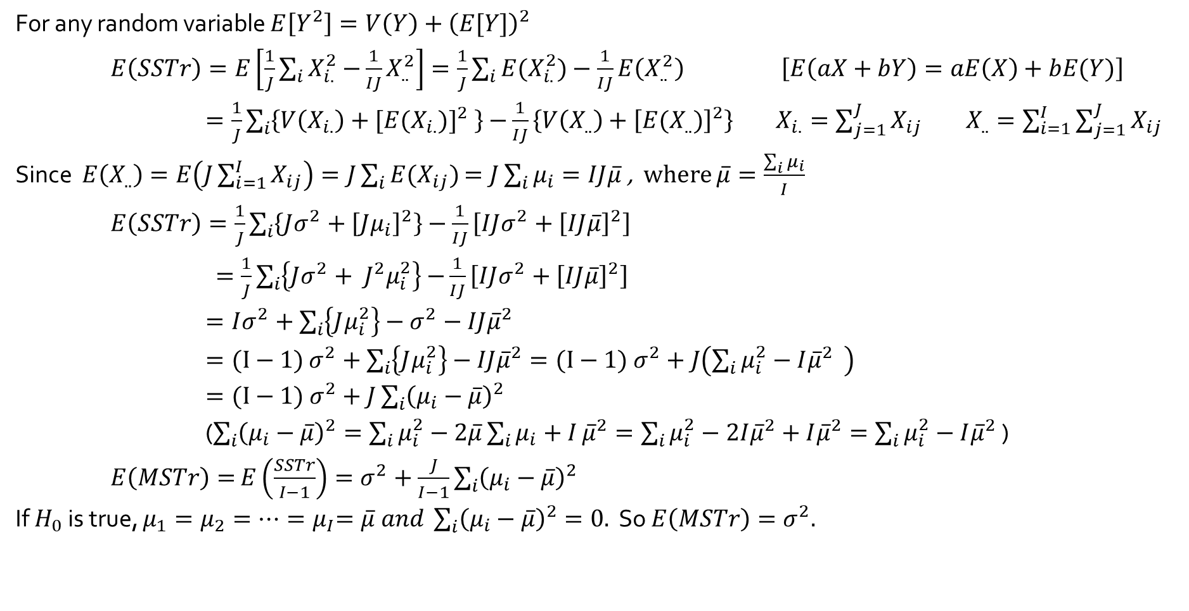
$E\left(MSTr\right)=σ^{2}$ if $H_{0}$ is true
For any random variable $E\left[Y^{2}\right]=V\left(Y\right)+{\left(E[Y]\right)}^{2}$
$E\left(SSTr\right)=E\left[\frac{1}{J}\sum_{i}{X_{i.}^{2}−}\frac{1}{IJ}X_{..}^{2}\right]=\frac{1}{J}\sum_{i}{{E(X}_{i.}^{2})}−\frac{1}{IJ}E\left(X_{..}^{2}\right)$ $\left[E\left(aX+bY\right)=aE\left(X\right)+bE(Y)\right]$
$=\frac{1}{J}\sum_{i}{\left\{V\left(X_{i.}\right)+[{E(X_{i.})]}^{2} \right\}−}\frac{1}{IJ}\left\{V\left(X_{..}\right)+{\left[E(X_{..})\right]}^{2}\right\}$ $X_{i.}=\sum_{j=1}^{J}{X_{ij}}$ $X_{..}=\sum_{i=1}^{I}{\sum_{j=1}^{J}{X_{ij}}}$
Since $E\left(X_{..}\right)=E\left(J\sum_{i=1}^{I}{X_{ij}}\right)=J\sum_{i}{E(X_{ij})}$ $=J\sum_{i}{μ_{i}}=IJ\overline{μ}$ , where $\overline{μ}=\frac{\sum_{i}{μ_{i}}}{I}$
$E\left(SSTr\right)=\frac{1}{J}\sum_{i}{\left\{Jσ^{2}+{\left[Jμ_{i}\right]}^{2}\right\}}−\frac{1}{IJ}\left[IJσ^{2}+{\left[IJ\overline{μ}\right]}^{2}\right]$
$=\frac{1}{J}\sum_{i}{\left\{Jσ^{2}+ J^{2}μ_{i}^{2}\right\}}$ $−\frac{1}{IJ}\left[IJσ^{2}+{\left[IJ\overline{μ}\right]}^{2}\right]$
$=Iσ^{2}+\sum_{i}{\left\{Jμ_{i}^{2}\right\}}−σ^{2}−IJ{\overline{μ}}^{2}$
$=(I−1)$ $σ^{2}+\sum_{i}{\left\{Jμ_{i}^{2}\right\}}−IJ{\overline{μ}}^{2}=(I−1) σ^{2}+J\left(\sum_{i}{μ_{i}^{2}}−I{\overline{μ}}^{2} \right)$
$=(I−1) σ^{2}+J\sum_{i}{{\left(μ_{i}−\overline{μ}\right)}^{2}}$
($\sum_{i}{{\left(μ_{i}−\overline{μ}\right)}^{2}}=\sum_{i}{μ_{i}^{2}}−2\overline{μ}\sum_{i}{μ_{i}+I}{\overline{μ}}^{2}=\sum_{i}{μ_{i}^{2}}−2I{\overline{μ}}^{2}+I{\overline{μ}}^{2}=\sum_{i}{μ_{i}^{2}}−I{\overline{μ}}^{2}$ )
$E\left(MSTr\right)=$ $E\left(\frac{SSTr}{I−1}\right)=σ^{2}+\frac{J}{I−1}\sum_{i}{{\left(μ_{i}−\overline{μ}\right)}^{2}}$
If $H_{0}$ is true, $μ_{1}=μ_{2}=⋯{=μ}_{I}=\overline{μ} and \sum_{i}{{\left(μ_{i}−\overline{μ}\right)}^{2}}=0.$ So $E\left(MSTr\right)=σ^{2}.$

Slide 6
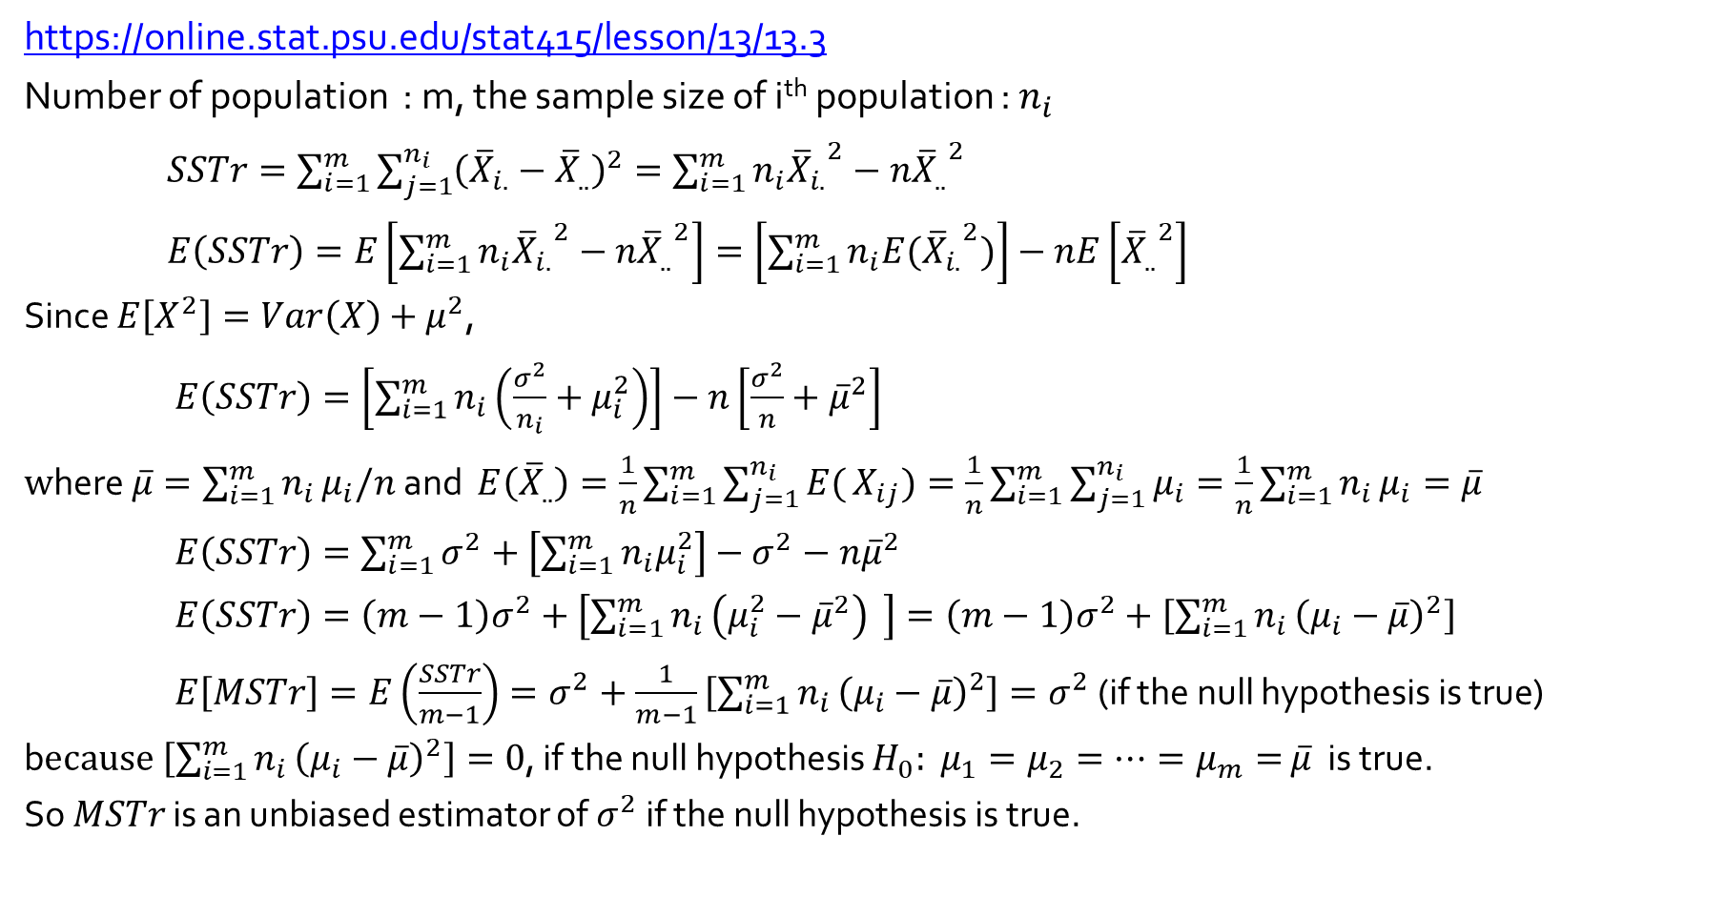
Theoretical Results | Stat 414/415 – Statistics Online – Penn State
https://online.stat.psu.edu/stat415/lesson/13/13.3
Number of population : m, the sample size of i^{th} population : $n_{i}$
$SSTr=\sum_{i=1}^{m}{\sum_{j=1}^{n_{i}}{{\left({\overline{X}}_{i.}−{\overline{X}}_{..}\right)}^{2}}}=\sum_{i=1}^{m}{n_{i}{{\overline{X}}_{i.}}^{2}}−n{{\overline{X}}_{..}}^{2}$
$E\left(SSTr\right)=E\left[\sum_{i=1}^{m}{n_{i}{{\overline{X}}_{i.}}^{2}}−n{{\overline{X}}_{..}}^{2}\right]=\left[\sum_{i=1}^{m}{n_{i}{{E(\overline{X}}_{i.}}^{2})}\right]−nE\left[{{\overline{X}}_{..}}^{2}\right]$
Since $E\left[X^{2}\right]=Var\left(X\right)+μ^{2}$,
$E\left(SSTr\right)=\left[\sum_{i=1}^{m}{n_{i}\left(\frac{σ^{2}}{n_{i}}+μ_{i}^{2}\right)}\right]−n\left[\frac{σ^{2}}{n}+{\overline{μ}}^{2}\right]$
$w$here $\overline{μ}=\sum_{i=1}^{m}{n_{i}}μ_{i}/n$ and $E\left({\overline{X}}_{..}\right)=\frac{1}{n}\sum_{i=1}^{m}{\sum_{j=1}^{n_{i}}{E(}}X_{ij})=\frac{1}{n}\sum_{i=1}^{m}{\sum_{j=1}^{n_{i}}{μ_{i}}}=\frac{1}{n}\sum_{i=1}^{m}{n_{i}}μ_{i}=\overline{μ}$
$E\left(SSTr\right)=\sum_{i=1}^{m}{σ^{2}}+\left[\sum_{i=1}^{m}{n_{i}μ_{i}^{2}}\right]−σ^{2}−n{\overline{μ}}^{2}$
$E\left(SSTr\right)=\left(m−1\right)σ^{2}+\left[\sum_{i=1}^{m}{n_{i}}\left(μ_{i}^{2}−{\overline{μ}}^{2}\right) \right]=\left(m−1\right)σ^{2}+\left[\sum_{i=1}^{m}{n_{i}}{\left(μ_{i}−\overline{μ}\right)}^{2}\right]$
$E\left[MSTr\right]=E\left(\frac{SSTr}{m−1}\right)=σ^{2}+\frac{1}{m−1}\left[\sum_{i=1}^{m}{n_{i}}{\left(μ_{i}−\overline{μ}\right)}^{2}\right]=σ^{2}$ (if the null hypothesis is true)
b$ecause \left[\sum_{i=1}^{m}{n_{i}}{\left(μ_{i}−\overline{μ}\right)}^{2}\right]=0$, if the null hypothesis $H_{0}:$ $μ_{1}=μ_{2}=⋯=μ_{m}=$ $\overline{μ}$ is true.
So $MSTr$ is an unbiased estimator of $σ^{2}$ if the null hypothesis is true.

